Slide 1
RUSTikales Rust for beginners
©Philippe Felix Haupt 2023

Slide 2
Plan for today
©Philippe Felix Haupt 2023

Slide 3
Plan for today
Recap
©Philippe Felix Haupt 2023

Slide 4
Plan for today
Recap
Traits
©Philippe Felix Haupt 2023

Slide 5
Plan for today
Recap
Traits
Declaration and Usage
©Philippe Felix Haupt 2023

Slide 6
Plan for today
Recap
Traits
Declaration and Usage
Debug, Display
©Philippe Felix Haupt 2023

Slide 7
Plan for today
Recap
Traits
Declaration and Usage
Debug, Display
Move, Copy, Clone
©Philippe Felix Haupt 2023

Slide 8
Recap
©Philippe Felix Haupt 2023

Slide 9
Recap
Ownership-Model
Borrowing
Borrow Checker
©Philippe Felix Haupt 2023

Slide 10
Recap
Ownership-Model
Borrowing
Borrow Checker
Functions
Declared using keyword fn
Take in a list of parameters/arguments
Can return values
©Philippe Felix Haupt 2023

Slide 11
Recap
Ownership-Model
Borrowing
Borrow Checker
Functions
Structs
Declared using the keyword struct
Made out of fields
Field names must be unique
Count as type definition
©Philippe Felix Haupt 2023

Slide 12
Recap
Ownership-Model
Borrowing
Borrow Checker
Functions
Structs
Declared using the keyword struct
Made out of fields
Field names must be unique
Count as type definition
Can be used as parameter and variable types
Can be used as field type
etc
©Philippe Felix Haupt 2023

Slide 13
Recap
Ownership-Model
Borrowing
Borrow Checker
Functions
Structs
Associated functions
Declared using the keyword impl
Declared like normal functions
Used by calling <struct>::<fn_name>()
©Philippe Felix Haupt 2023

Slide 14
Recap
Ownership-Model
Borrowing
Borrow Checker
Functions
Structs
Associated functions
Methods
Associated functions where the first parameter is either self, &self or &mut self
Can be called on instances of structs using <instance>.<fn_name>()
©Philippe Felix Haupt 2023

Slide 15
Recap
Ownership-Model
Borrowing
Borrow Checker
Functions
Structs
Associated functions
Methods
Order of struct and impl declarations does not matter
©Philippe Felix Haupt 2023

Slide 16
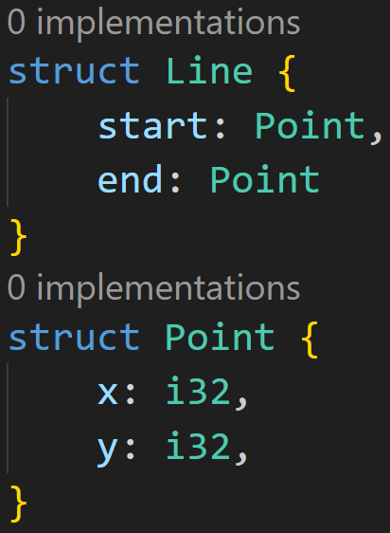
Recap
©Philippe Felix Haupt 2023

Slide 17
Recap
Struct declaration
Struct declaration
©Philippe Felix Haupt 2023

Slide 18
Recap
Struct defined here
©Philippe Felix Haupt 2023

Slide 19
Recap
Can be used here
Struct defined here
©Philippe Felix Haupt 2023

Slide 20
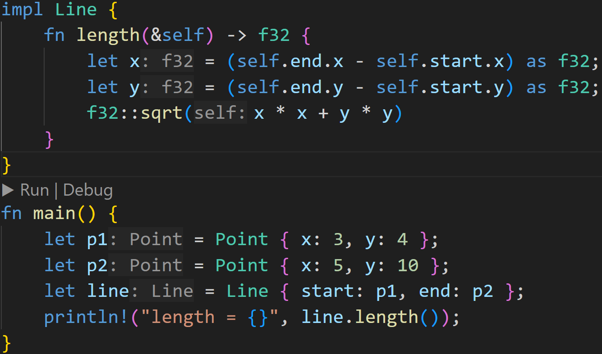
Recap
©Philippe Felix Haupt 2023

Slide 21
Recap
Method
©Philippe Felix Haupt 2023

Slide 22
Recap
Method
call to associated function
©Philippe Felix Haupt 2023

Slide 23
Recap
Method
call to associated function
call to method on instance line
©Philippe Felix Haupt 2023

Slide 24
Recap
Method
call to associated function
Ownership of Points behind p1 and p2 goes to line here!
call to method on instance line
©Philippe Felix Haupt 2023

Slide 25
Traits
©Philippe Felix Haupt 2023

Slide 26
Traits
Structs and methods are very powerful, but also pretty limited right now
©Philippe Felix Haupt 2023

Slide 27
Traits
Structs and methods are very powerful, but also pretty limited right now
We can’t print them to the console
Ownership problems, we can only move our structs
©Philippe Felix Haupt 2023

Slide 28
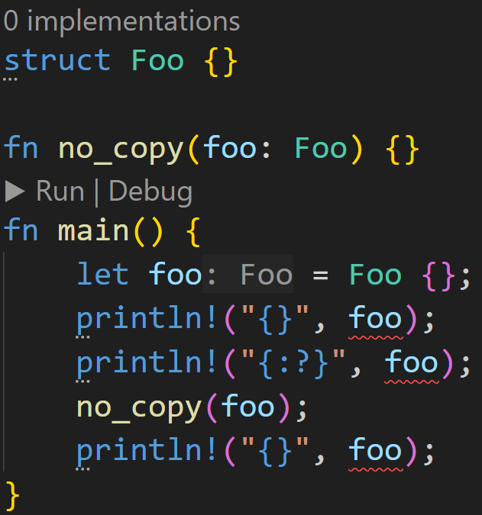
Traits
©Philippe Felix Haupt 2023

Slide 29
Traits
Can’t print normally
©Philippe Felix Haupt 2023

Slide 30
Traits
Can’t print normally
Can’t debug print
©Philippe Felix Haupt 2023

Slide 31
Traits
Can’t print normally
Can’t debug print
foo is moved, can’t use it below
©Philippe Felix Haupt 2023

Slide 32
Traits
Structs and methods are very powerful, but also pretty limited right now
We can’t print them to the console
Ownership problems, we can’t move our structs
To deal with this, Rust has the trait system
©Philippe Felix Haupt 2023

Slide 33
Traits
Structs and methods are very powerful, but also pretty limited right now
We can’t print them to the console
Ownership problems, we can’t move our structs
To deal with this, Rust has the trait system
Traits are like a contract:
A trait consists of function declarations
If you want to use a trait for a struct, you need to define the functions for your struct
©Philippe Felix Haupt 2023

Slide 34
Traits
Structs and methods are very powerful, but also pretty limited right now
We can’t print them to the console
Ownership problems, we can’t move our structs
To deal with this, Rust has the trait system
Traits are like a contract:
A trait consists of function declarations
If you want to use a trait for a struct, you need to define the functions for your struct
Traits can be defined using the keyword trait
©Philippe Felix Haupt 2023

Slide 35
Traits
Structs and methods are very powerful, but also pretty limited right now
We can’t print them to the console
Ownership problems, we can’t move our structs
To deal with this, Rust has the trait system
Traits are like a contract:
A trait consists of function declarations
If you want to use a trait for a struct, you need to define the functions for your struct
Traits can be defined using the keyword trait
Implementing a trait for a struct is similar to associated functions: impl <trait_name> for <struct_name> { … }
©Philippe Felix Haupt 2023

Slide 36
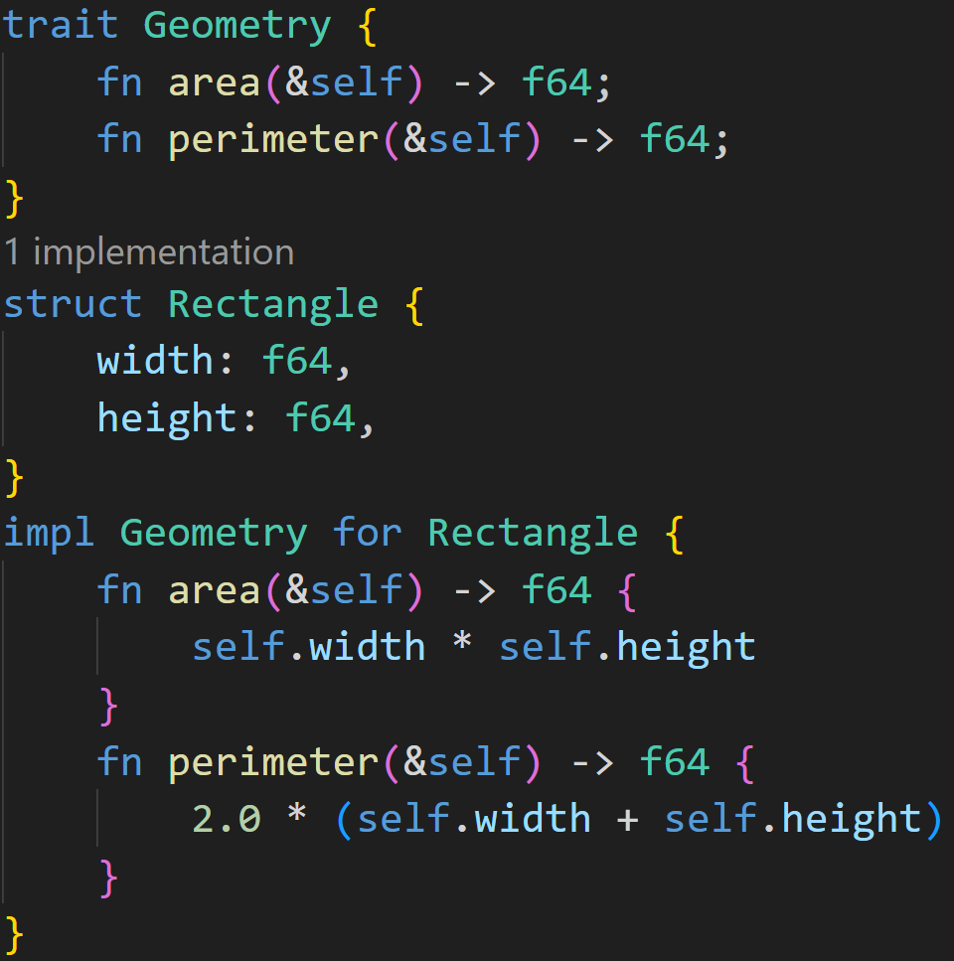
Traits
©Philippe Felix Haupt 2023

Slide 37
Traits
Define trait Geometry with two functions: area and perimeter
©Philippe Felix Haupt 2023

Slide 38
Traits
Normally, traits do not define a function body
©Philippe Felix Haupt 2023

Slide 39
Traits
Normally, traits do not define a function body
All we later care about is that those functions exist, we don’t care about what they’re doing
©Philippe Felix Haupt 2023

Slide 40
Traits
Normally, traits do not define a function body
All we later care about is that those functions exist, we don’t care about what they’re doing In most cases, we couldn’t even give a base implementation, like here: What’s the base area for every possible object?
©Philippe Felix Haupt 2023

Slide 41
Traits
Implement trait for our struct
©Philippe Felix Haupt 2023

Slide 42
Traits
We need to implement every function of a trait, and we need to respect the signature
Implement trait for our struct
©Philippe Felix Haupt 2023

Slide 43
Traits
We need to implement every function of a trait, and we need to respect the signature:
Parameters must be identical
Same count
Same type
Return type must match
Name must match
©Philippe Felix Haupt 2023

Slide 44
Traits
We need to implement every function of a trait, and we need to respect the signature:
Parameters must be identical
Same count
Same type
Return type must match
Name must match
Here it means: Implement two methods which return the area and perimeter of that instance
©Philippe Felix Haupt 2023

Slide 45
Traits
We need to implement every function of a trait, and we need to respect the signature:
Parameters must be identical
Same count
Same type
Return type must match
Name must match
Here it means: Implement two methods which return the area and perimeter of that instance
We do that here! Everything’s fine
©Philippe Felix Haupt 2023

Slide 46
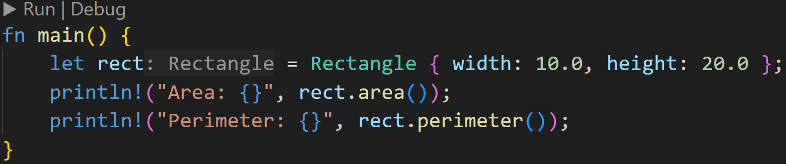
Traits
Implementing a trait allows us to use the defined functions as we would use associated functions, or methods
©Philippe Felix Haupt 2023

Slide 47
Traits
Implementing a trait allows us to use the defined functions as we would use associated functions, or methods
But isn’t that kinda redundant, what do we gain from doing that?
3/3
©Philippe Felix Haupt 2023

Slide 48
Traits
Implementing a trait allows us to use the defined functions as we would use associated functions, or methods
But isn’t that kinda redundant, what do we gain from doing that?
We can generalize our code to take in any struct that implements a given trait
©Philippe Felix Haupt 2023

Slide 49
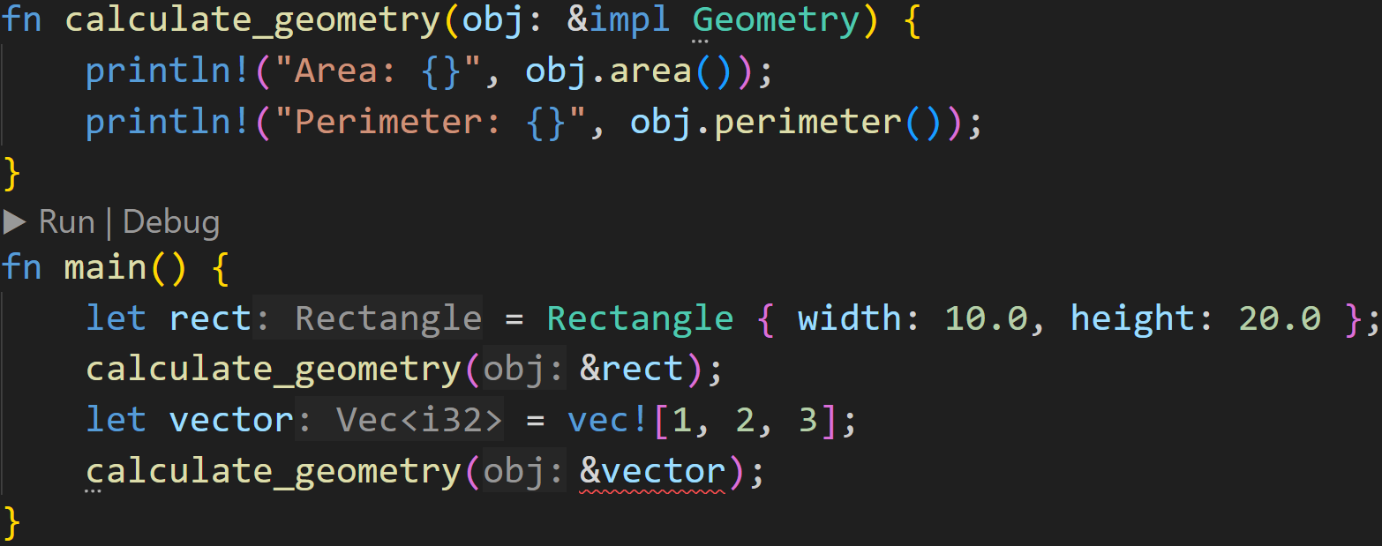
Traits
©Philippe Felix Haupt 2023

Slide 50
Traits
We do not care about the type of the parameter, as long as it implements the Geometry trait it’s fine! :)
©Philippe Felix Haupt 2023

Slide 51
Traits
We do not care about the type of the parameter, as long as it implements the Geometry trait it’s fine! :)
Rectangle implements Geometry
©Philippe Felix Haupt 2023

Slide 52
Traits
We do not care about the type of the parameter, as long as it implements the Geometry trait it’s fine! :)
Rectangle implements Geometry
Vec<T> does not :^)
©Philippe Felix Haupt 2023

Slide 53
Traits
With this mechanism, we can take a look at the compiler error for println!() earlier
©Philippe Felix Haupt 2023

Slide 54
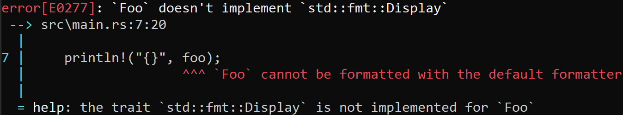
Traits
With this mechanism, we can take a look at the compiler error for println!() earlier
©Philippe Felix Haupt 2023

Slide 55
Traits
With this mechanism, we can take a look at the compiler error for println!() earlier
Aha!
©Philippe Felix Haupt 2023

Slide 56
Traits
With this mechanism, we can take a look at the compiler error for println!() earlier
We can just follow the compiler errors until it works :)
©Philippe Felix Haupt 2023

Slide 57
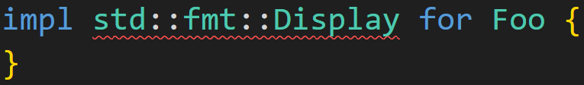
Traits
With this mechanism, we can take a look at the compiler error for println!() earlier
We can just follow the compiler errors until it works :)
It wanted std::fmt::Display for Foo, so let’s do that:
©Philippe Felix Haupt 2023

Slide 58
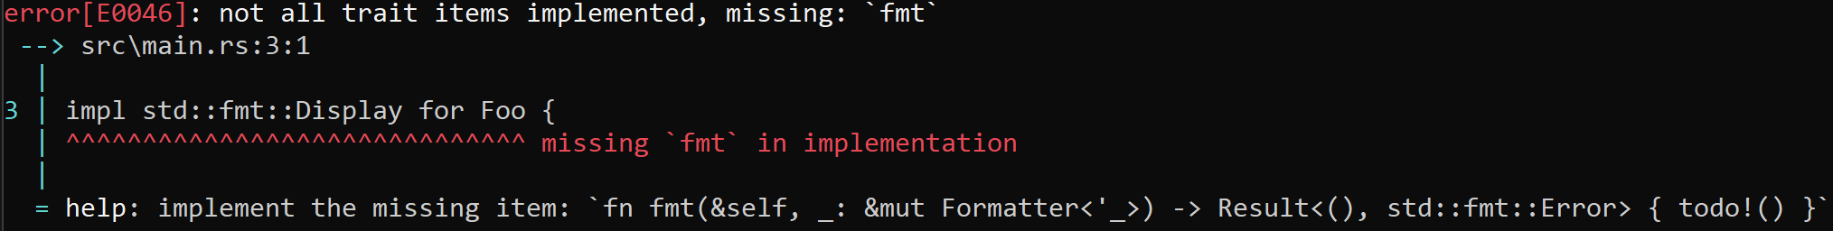
Traits
With this mechanism, we can take a look at the compiler error for println!() earlier
We can just follow the compiler errors until it works :)
It wanted std::fmt::Display for Foo, so let’s do that:
Hm, missing some function definitions!
©Philippe Felix Haupt 2023

Slide 59
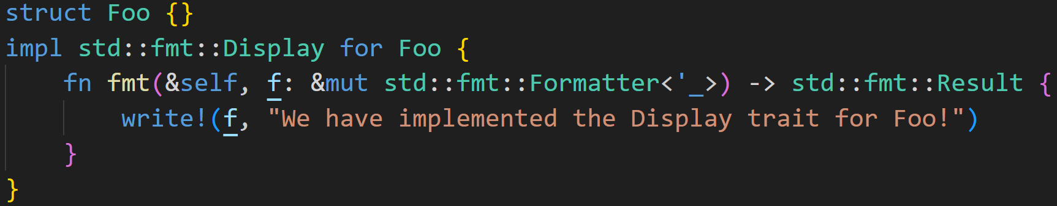
Traits
With this mechanism, we can take a look at the compiler error for println!() earlier
We can just follow the compiler errors until it works :)
It wanted std::fmt::Display for Foo, so let’s do that:
©Philippe Felix Haupt 2023

Slide 60
Traits
With this mechanism, we can take a look at the compiler error for println!() earlier
We can just follow the compiler errors until it works :)
It wanted std::fmt::Display for Foo, so let’s do that:
Scary, but you can ignore that most of the time :)
©Philippe Felix Haupt 2023

Slide 61
Traits
With this mechanism, we can take a look at the compiler error for println!() earlier
We can just follow the compiler errors until it works :)
It wanted std::fmt::Display for Foo, so let’s do that:
The `fmt` function it wanted!
©Philippe Felix Haupt 2023

Slide 62
Traits
With this mechanism, we can take a look at the compiler error for println!() earlier
We can just follow the compiler errors until it works :)
It wanted std::fmt::Display for Foo, so let’s do that:
We have now implemented the Display trait, and can use println!(“{}”) for Foo :)
©Philippe Felix Haupt 2023

Slide 63
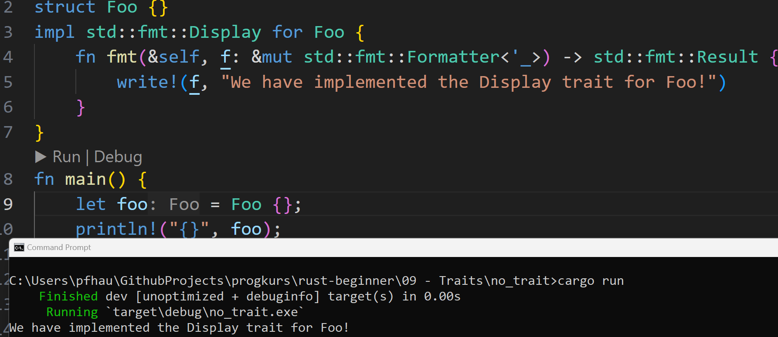
Traits
©Philippe Felix Haupt 2023

Slide 64
Traits
The “{}” formatter calls to Display::fmt() in the background, which is why we need to implement the trait
©Philippe Felix Haupt 2023

Slide 65
Intermission - Strings
write!, format!, print! - A lot of macros make use of Strings, but what is that?
©Philippe Felix Haupt 2023

Slide 66
Intermission - Strings
write!, format!, print! - A lot of macros make use of Strings, but what is that?
We’ve come a long way without ever using Strings, it is now time to introduce them
©Philippe Felix Haupt 2023

Slide 67
Intermission - Strings
write!, format!, print! - A lot of macros make use of Strings, but what is that?
We’ve come a long way without ever using Strings, it is now time to introduce them
Rust has two String types: &str and String
©Philippe Felix Haupt 2023

Slide 68
Intermission - Strings
write!, format!, print! - A lot of macros make use of Strings, but what is that?
We’ve come a long way without ever using Strings, it is now time to introduce them
Rust has two String types: &str and String
Both essentially do the same thing: They are collections of characters
©Philippe Felix Haupt 2023

Slide 69
Intermission - Strings
write!, format!, print! - A lot of macros make use of Strings, but what is that?
We’ve come a long way without ever using Strings, it is now time to introduce them
Rust has two String types: &str and String
Both essentially do the same thing: They are collections of characters
You can think of them as Arrays and Vectors:
&str is basically an Array: On the data section of your executable, not resizable
String is basically a Vector: On the heap, resizable
©Philippe Felix Haupt 2023

Slide 70
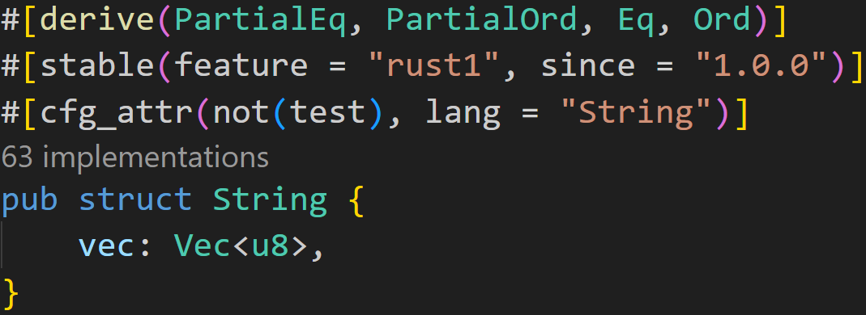
Intermission - Strings
write!, format!, print! - A lot of macros make use of Strings, but what is that?
We’ve come a long way without ever using Strings, it is now time to introduce them
Rust has two String types: &str and String
Both essentially do the same thing: They are collections of characters
You can think of them as Arrays and Vectors:
&str is basically an Array: On the data section of your executable, not resizable
String is basically a Vector: On the heap, resizable
String is literally a Vector! :^)
©Philippe Felix Haupt 2023

Slide 71
Intermission - Strings
write!, format!, print! - A lot of macros make use of Strings, but what is that?
We’ve come a long way without ever using Strings, it is now time to introduce them
Rust has two String types: &str and String
Both essentially do the same thing: They are collections of characters
You can think of them as Arrays and Vectors:
&str is basically an Array: On the data section of your executable, not resizable
String is basically a Vector: On the heap, resizable
Strings in Rust are UTF-8 encoded, which means you can have arabic, cyrillic or japanese characters in your String literals, and even emojis
©Philippe Felix Haupt 2023

Slide 72
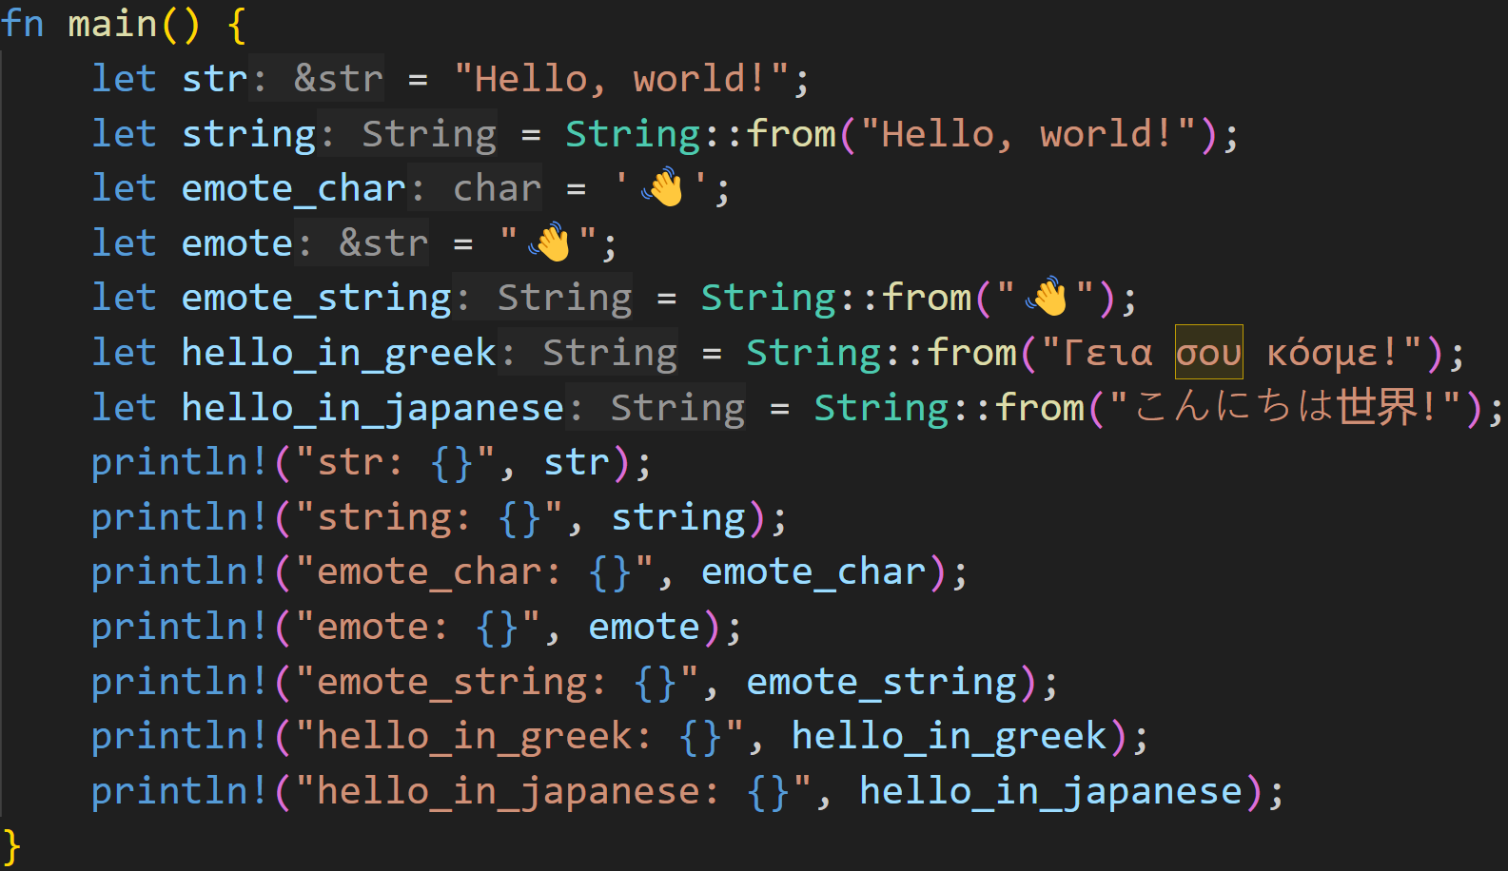
Intermission - Strings
©Philippe Felix Haupt 2023

Slide 73
Intermission - Strings
String literals are always of type &str
©Philippe Felix Haupt 2023

Slide 74
Intermission - Strings
associated function takes a &str and converts it to a String
©Philippe Felix Haupt 2023

Slide 75
Intermission - Strings
Editor warning, char could be confused
©Philippe Felix Haupt 2023

Slide 76
Intermission - Strings
©Philippe Felix Haupt 2023

Slide 77
Intermission - Strings
Everything can be encoded in UTF-8 :)
©Philippe Felix Haupt 2023

Slide 78
Intermission - Strings
Also UTF-8 :)
©Philippe Felix Haupt 2023

Slide 79
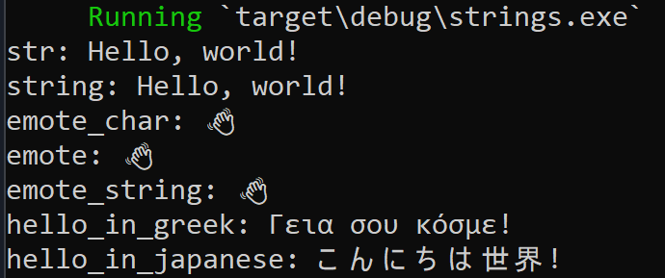
Intermission - Strings
©Philippe Felix Haupt 2023

Slide 80
Intermission - format!()
format!() is an important macro to turn any value into a String, for example to print it
©Philippe Felix Haupt 2023

Slide 81
Intermission - format!()
format!() is an important macro to turn any value into a String, for example to print it
The first argument is the format string, in it you build your string by providing placeholders for the values you want to format
©Philippe Felix Haupt 2023

Slide 82
Intermission - format!()
format!() is an important macro to turn any value into a String, for example to print it
The first argument is the format string, in it you build your string by providing placeholders for the values you want to format
Commonly used placeholders in Rust:
{} → std::fmt::Display
{:?} → std::fmt::Debug
{:#?} → Debug, but pretty printed
©Philippe Felix Haupt 2023

Slide 83
Intermission - format!()
format!() is an important macro to turn any value into a String, for example to print it
The first argument is the format string, in it you build your string by providing placeholders for the values you want to format
Commonly used placeholders in Rust:
{} → std::fmt::Display
{:?} → std::fmt::Debug
{:#?} → Debug, but pretty printed
Other placeholders exist, but are (usually) only used for numbers:
{:o} → std::fmt::Octal
{:x} → std::fmt::LowerHex
{:b} → std::fmt::Binary
©Philippe Felix Haupt 2023

Slide 84
Intermission - format!()
format!() is an important macro to turn any value into a String, for example to print it
The first argument is the format string, in it you build your string by providing placeholders for the values you want to format
For each placeholder you specify, you need to pass an additional argument to format!():
The value that goes into that place
©Philippe Felix Haupt 2023

Slide 85
Intermission - format!()
format!() is an important macro to turn any value into a String, for example to print it
The first argument is the format string, in it you build your string by providing placeholders for the values you want to format
For each placeholder you specify, you need to pass an additional argument to format!():
The value that goes into that place
Rust then does the correct calls to the correct trait in the background, failing when it can’t find an implementation
©Philippe Felix Haupt 2023

Slide 86
Intermission - format!()
format!() is an important macro to turn any value into a String, for example to print it
The first argument is the format string, in it you build your string by providing placeholders for the values you want to format
For each placeholder you specify, you need to pass an additional argument to format!():
The value that goes into that place
Rust then does the correct calls to the correct trait in the background, failing when it can’t find an implementation
format!() allows named arguments
©Philippe Felix Haupt 2023

Slide 87
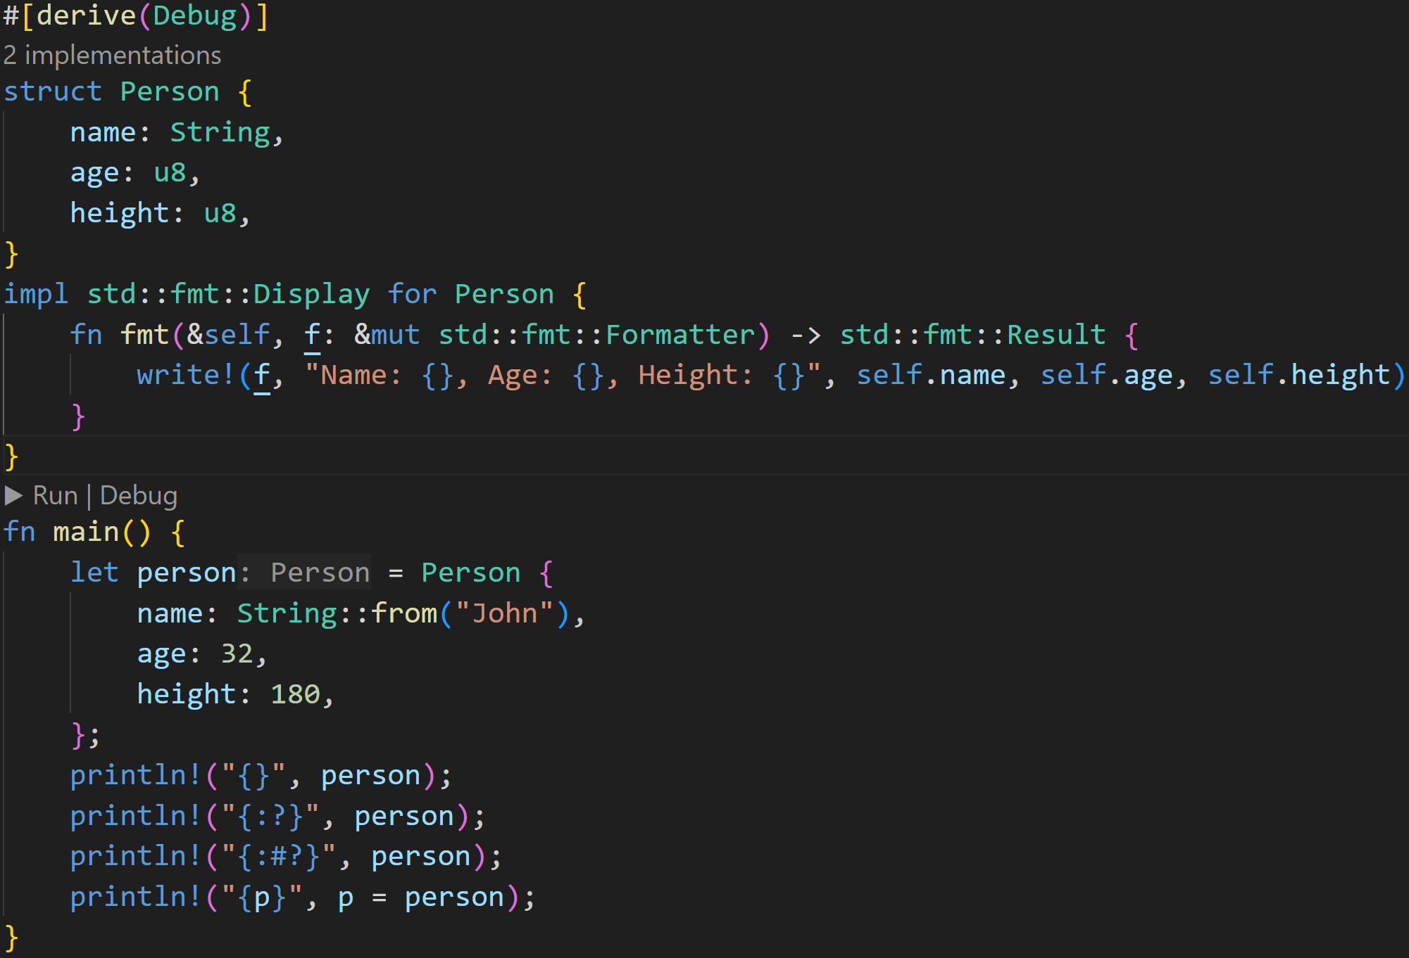
Intermission - format!()
©Philippe Felix Haupt 2023

Slide 88
Intermission - format!()
Usage of println! identical to format!: First the format string, then the values
©Philippe Felix Haupt 2023

Slide 89
Intermission - format!()
Debug is a derivable macro, and usually always implemented that way
Both call to that Debug implementation
©Philippe Felix Haupt 2023

Slide 90
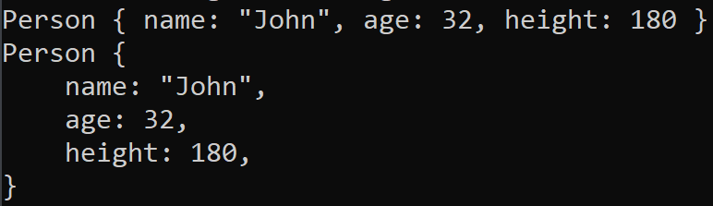
Intermission - format!()
Debug output:
©Philippe Felix Haupt 2023

Slide 91
Intermission - format!()
Debug is derivable, because it follows a simple formula:
For every field in your struct: → Collect debug format output of that field → field_name: field_value
Print that
©Philippe Felix Haupt 2023

Slide 92
Intermission - format!()
format field name
©Philippe Felix Haupt 2023

Slide 93
Intermission - format!()
format field age
©Philippe Felix Haupt 2023

Slide 94
Intermission - format!()
format field height
©Philippe Felix Haupt 2023

Slide 95
Intermission - format!()
{:#?} just adds newlines :)
©Philippe Felix Haupt 2023

Slide 96
Intermission - format!()
This calls to the implementation of Display, which is given above
©Philippe Felix Haupt 2023

Slide 97
Intermission - format!()
Essentially also uses format!() internally Difference: write!() requires a formatter as first argument, which is kindly given as a parameter and just passed along :)
This calls to the implementation of Display, which is given above
©Philippe Felix Haupt 2023

Slide 98
Intermission - format!()
Note that write!() returns a value, which we also return in `fmt`!
It returns the result of writing, which might fail. More on Results later :^)
no semicolon!
This calls to the implementation of Display, which is given above
©Philippe Felix Haupt 2023

Slide 99
Intermission - format!()
Output:
©Philippe Felix Haupt 2023

Slide 100
Intermission - format!()
- Named arguments must be given last - For named Debug etc, use {p:?}
©Philippe Felix Haupt 2023

Slide 101
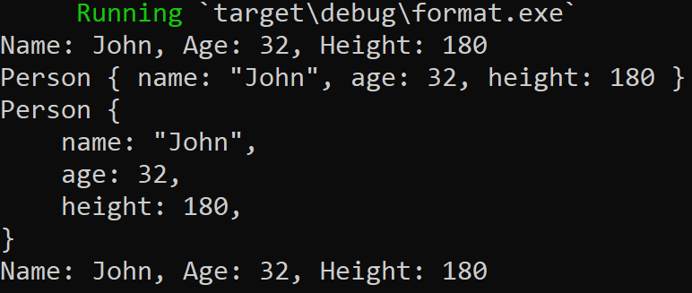
Intermission - format!()
©Philippe Felix Haupt 2023

Slide 102
Traits
Many things in Rust are only syntactic sugar for calls to traits
format!() and println!() call to Display and Debug, for example
©Philippe Felix Haupt 2023

Slide 103
Traits
Many things in Rust are only syntactic sugar for calls to traits
format!() and println!() call to Display and Debug, for example
Additionally, the following things are traits:
Arithmetic operations such as Addition and Subtraction
Comparisons such as Equal or LessThan
for-loops require the Iterator-Trait
©Philippe Felix Haupt 2023

Slide 104
Traits
Many things in Rust are only syntactic sugar for calls to traits
format!() and println!() call to Display and Debug, for example
Additionally, the following things are traits:
Arithmetic operations such as Addition and Subtraction
Comparisons such as Equal or LessThan
for-loops require the Iterator-Trait
This means that we could theoretically tell Rust how to add two persons together
©Philippe Felix Haupt 2023

Slide 105
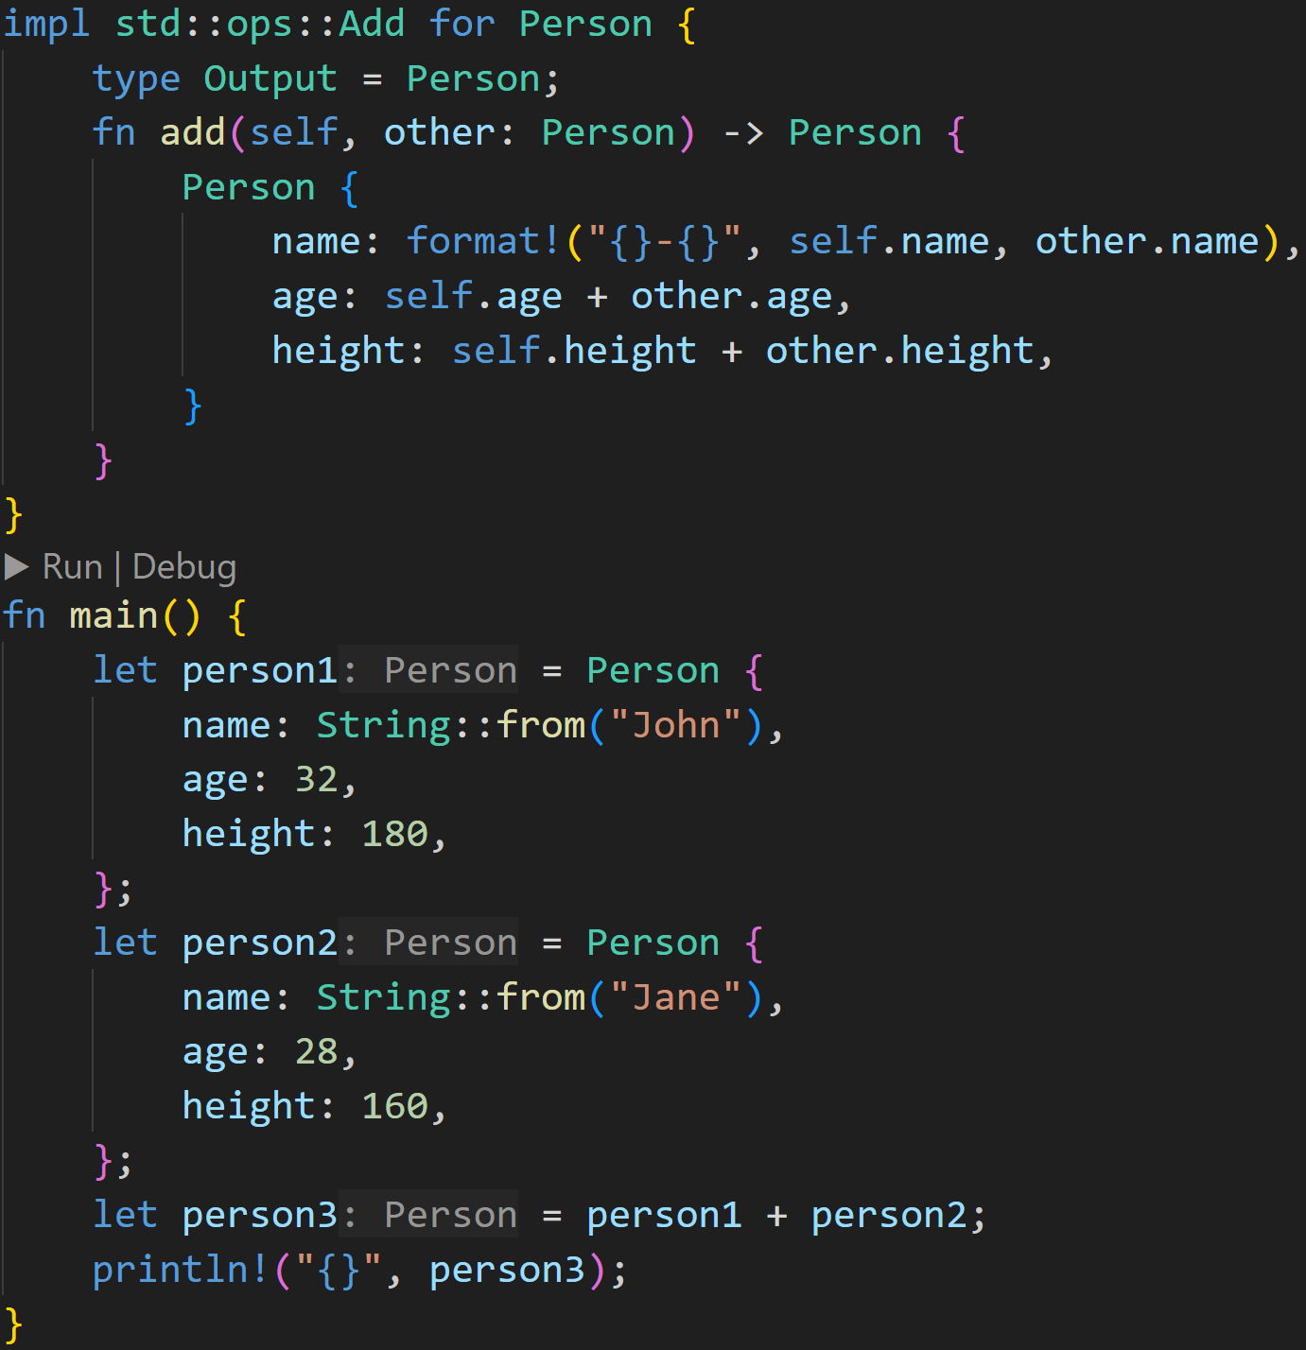
Traits
©Philippe Felix Haupt 2023

Slide 106
Traits
This is a call to Add::add(), which we implemented above :) Note that this consumes both persons
©Philippe Felix Haupt 2023

Slide 107
Traits
Many things in Rust are only syntactic sugar for calls to traits
format!() and println!() call to Display and Debug, for example
Additionally, the following things are traits:
Arithmetic operations such as Addition and Subtraction
Comparisons such as Equal or LessThan
for-loops require the Iterator-Trait
This means that we could theoretically tell Rust how to add two persons together
But more importantly, Ownership is also handled with traits :)
©Philippe Felix Haupt 2023

Slide 108
Traits
Many things in Rust are only syntactic sugar for calls to traits
format!() and println!() call to Display and Debug, for example
Additionally, the following things are traits:
Arithmetic operations such as Addition and Subtraction
Comparisons such as Equal or LessThan
for-loops require the Iterator-Trait
This means that we could theoretically tell Rust how to add two persons together
But more importantly, Ownership is also handled with traits :)
Structs in Rust are always moved, unless the Copy-trait is implemented
Copy is a derived trait, and only works if all fields can be copied
For our Person that doesn’t work, because String can’t be copied :^)
©Philippe Felix Haupt 2023

Slide 109
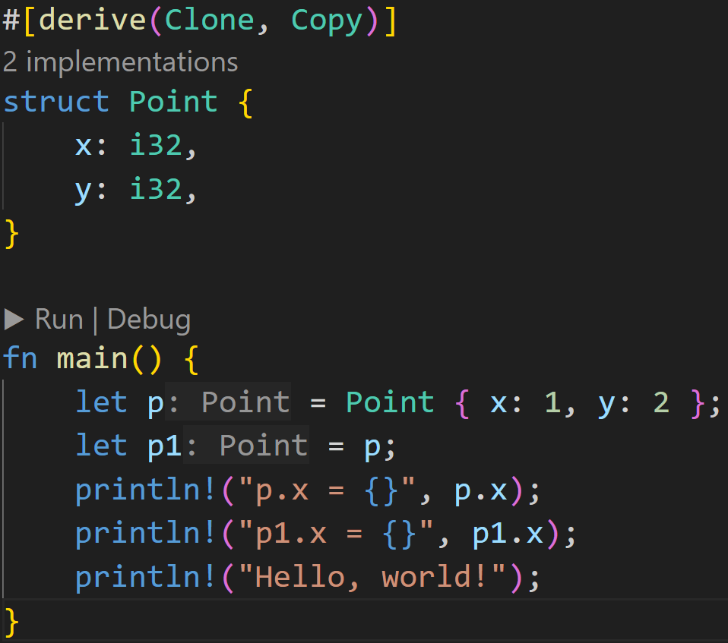
Traits
©Philippe Felix Haupt 2023

Slide 110
Traits
Clone is required for Copy to work, so we need to derive this too
©Philippe Felix Haupt 2023

Slide 111
Traits
Because we derived Copy, Rust no longer moves `p`! :)
©Philippe Felix Haupt 2023

Slide 112
Intermission - Exercise
Time for exercises!
©Philippe Felix Haupt 2023

Slide 113
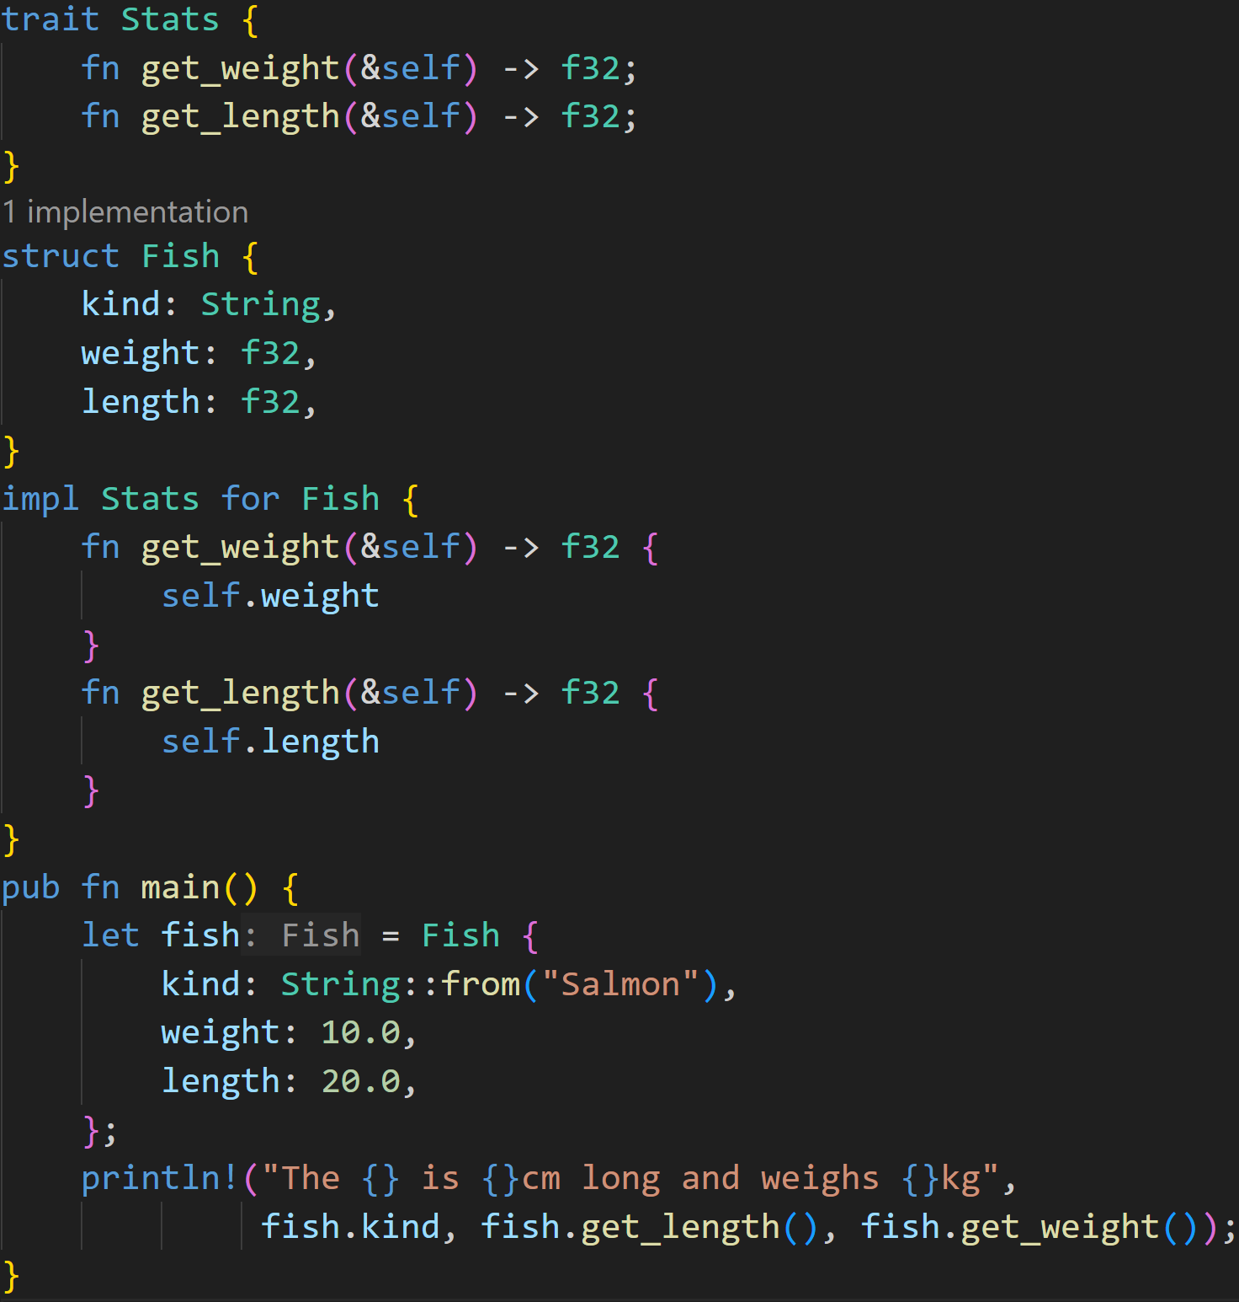
2/3
©Philippe Felix Haupt 2023

Slide 114
2/3
Does this example compile? If yes, what does it print?
©Philippe Felix Haupt 2023

Slide 115
2/3
Does this example compile? If yes, what does it print?
Yes, it does compile!
©Philippe Felix Haupt 2023

Slide 116
2/3
Does this example compile? If yes, what does it print?
Trait declaration
Yes, it does compile!
Trait Implementation
©Philippe Felix Haupt 2023

Slide 117

2/3
Does this example compile? If yes, what does it print?
Trait declaration
Yes, it does compile!
Trait Implementation
Output:
©Philippe Felix Haupt 2023

Slide 118
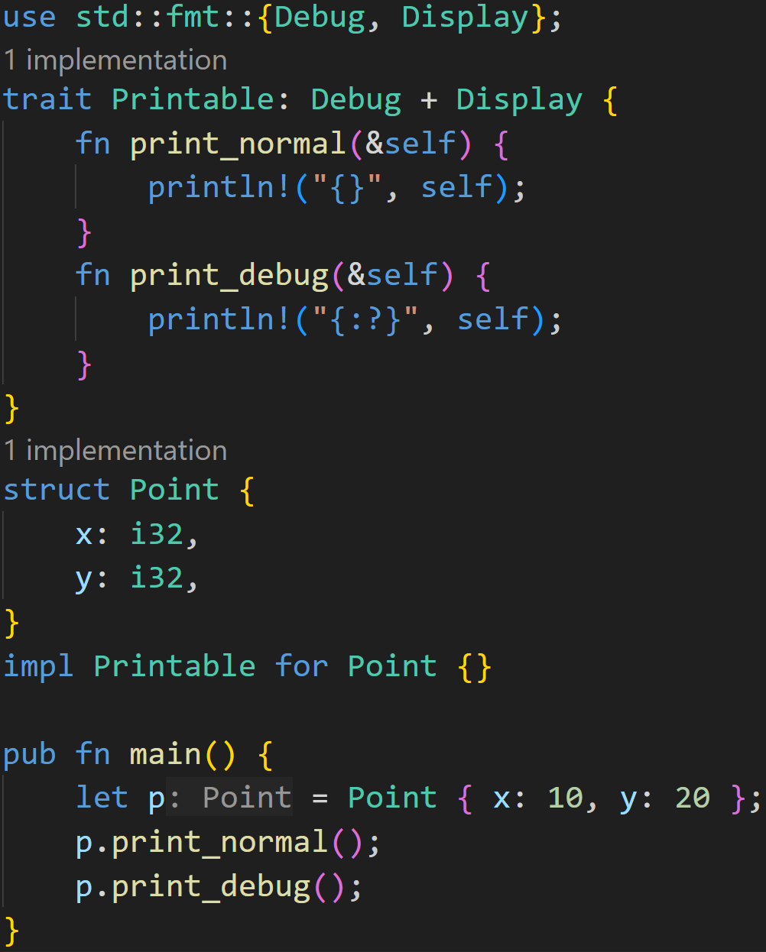
3/3
©Philippe Felix Haupt 2023

Slide 119
3/3
Does this example compile? If yes, what does it print?
©Philippe Felix Haupt 2023

Slide 120
3/3
Does this example compile? If yes, what does it print?
Supertraits: Anything that implements Printable must also implement Debug and Display
©Philippe Felix Haupt 2023

Slide 121
3/3
Does this example compile? If yes, what does it print?
Supertraits: Anything that implements Printable must also implement Debug and Display
This is okay, we actually provide function definitions in the trait (which is allowed in Rust)
©Philippe Felix Haupt 2023

Slide 122
3/3
Does this example compile? If yes, what does it print?
Supertraits: Anything that implements Printable must also implement Debug and Display
Point does not implement Debug and Display :(
This is okay, we actually provide function definitions in the trait (which is allowed in Rust)
©Philippe Felix Haupt 2023

Slide 123
3/3
Does this example compile? If yes, what does it print?
Supertraits: Anything that implements Printable must also implement Debug and Display
Point does not implement Debug and Display :(
→ Does not compile!
This is okay, we actually provide function definitions in the trait (which is allowed in Rust)
©Philippe Felix Haupt 2023

Slide 124
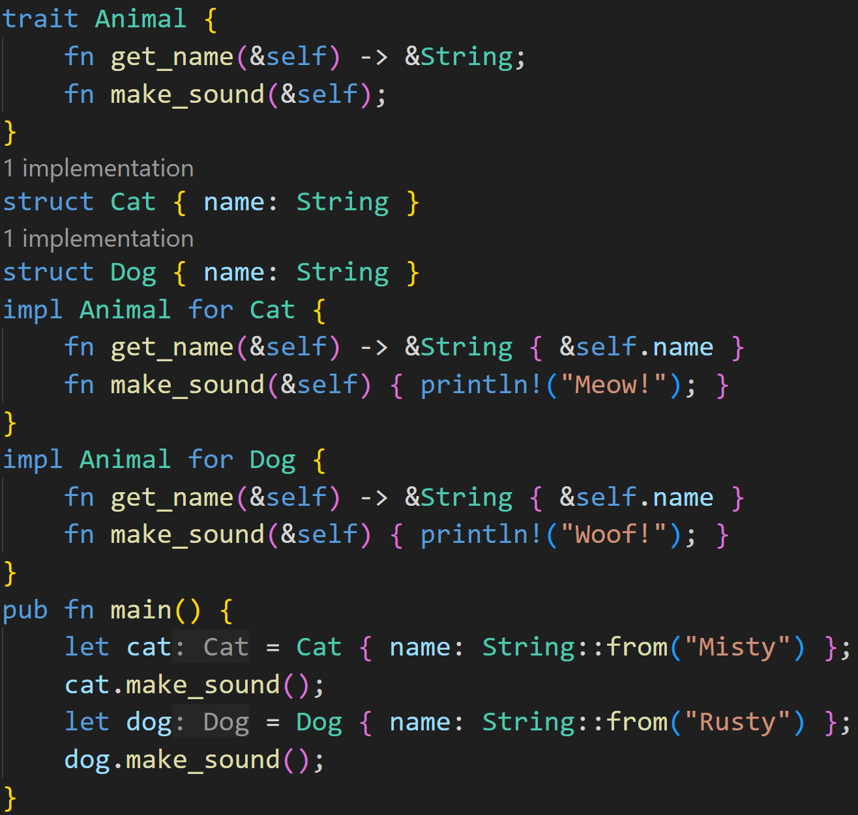
2/3
©Philippe Felix Haupt 2023

Slide 125
2/3
Does this example compile? If yes, what does it print?
©Philippe Felix Haupt 2023

Slide 126
2/3
Does this example compile? If yes, what does it print?
Trait declaration
Trait implementations
©Philippe Felix Haupt 2023

Slide 127
2/3
Does this example compile? If yes, what does it print?
Each struct defines all necessary functions, there are no supertraits or other things
©Philippe Felix Haupt 2023

Slide 128
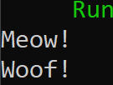
2/3
Does this example compile? If yes, what does it print?
Each struct defines all necessary functions, there are no supertraits or other things
This code compiles :)
©Philippe Felix Haupt 2023

Slide 129
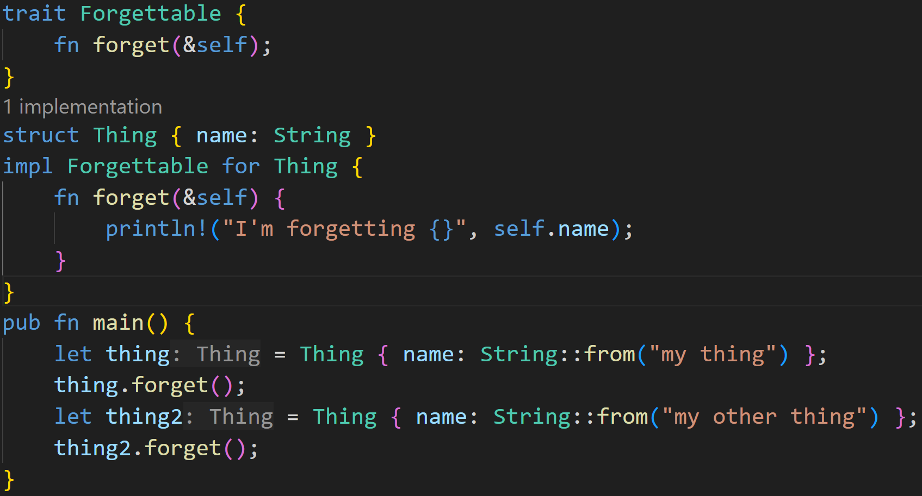
1/3
©Philippe Felix Haupt 2023

Slide 130
Does this example compile? If yes, what does it print?
1/3
©Philippe Felix Haupt 2023

Slide 131
Does this example compile? If yes, what does it print?
1/3
Trait declaration
Trait implementation
©Philippe Felix Haupt 2023

Slide 132
Does this example compile? If yes, what does it print?
1/3
Each struct defines all necessary functions, there are no supertraits or other things
©Philippe Felix Haupt 2023

Slide 133

Does this example compile? If yes, what does it print?
1/3
Each struct defines all necessary functions, there are no supertraits or other things
This code compiles :)
©Philippe Felix Haupt 2023

Slide 134
Next time
Enums
match
©Philippe Felix Haupt 2023

